Slide 1
Demonstration of the Implemented Arrest Front in the Sepal Model
Shuyao Kong
2020-02-02

Slide 2
Assumptions in the implemented arrest front
The sepal is able to sense its size relative to the range of the growth factor. When sepal height reaches a certain threshold, an arrest front (AF) is triggered at the sepal tip.
Subsequently, the AF propagates towards the base at a constant rate.
Two hypotheses on how ROS modulates sepal shape:
H1: ROS blocks plasmodesmata, which inhibits the diffusion of the growth factor
H2: ROS stiffens cell walls, so that the tissue beyond the AF increases its rigidity to K folds.

Slide 3
Hypothesis 1 barely affects sepal shape
Two hypotheses on how ROS modulates sepal shape:
H1: ROS blocks plasmodesmata, which inhibits the diffusion of the growth factor
Therefore in the subsequent sections, we assume hypothesis 2 is correct
H2: ROS stiffens cell walls, so that the tissue beyond the AF increases its rigidity to K folds.
Arrest front decreases diffusion constant by
0%
50%
100%
Final shape

Slide 4
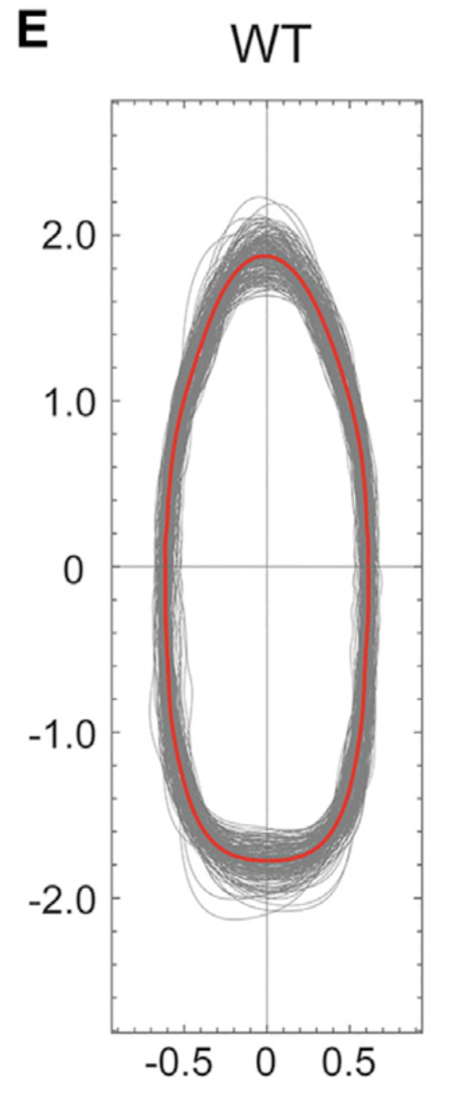
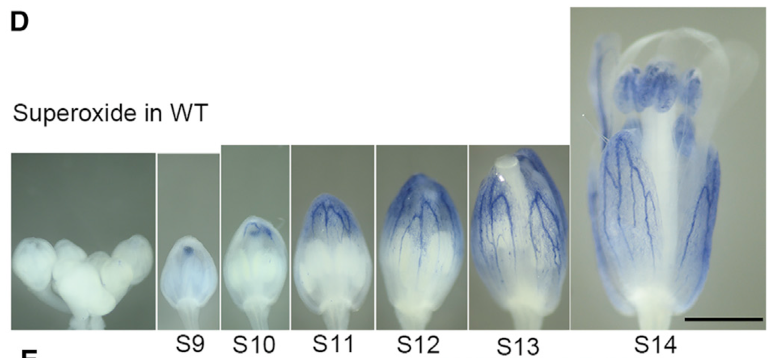
Tuning parameters of the arrest front
Goals of tuning:
The height:width ratio of the mature sepal should be 3
The height ratio of the mature sepal to one in which AF is triggered should be 2
Hong et al, Developmental Cell, 2016

Slide 5
Tuning parameters of the arrest front
Parameters that was tuned
The height of the sepal when AF is triggered
The propagation rate of the AF
The fold-change in rigidity due to ROS
Hong et al, Developmental Cell, 2016

Slide 6
The sepal model after parameter tuning
Rigidity
Hong et al, Developmental Cell, 2016

Slide 7
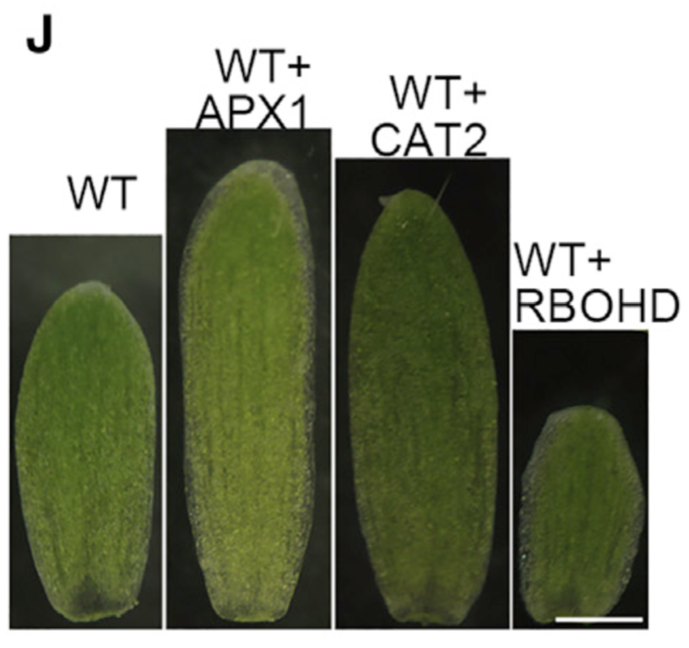
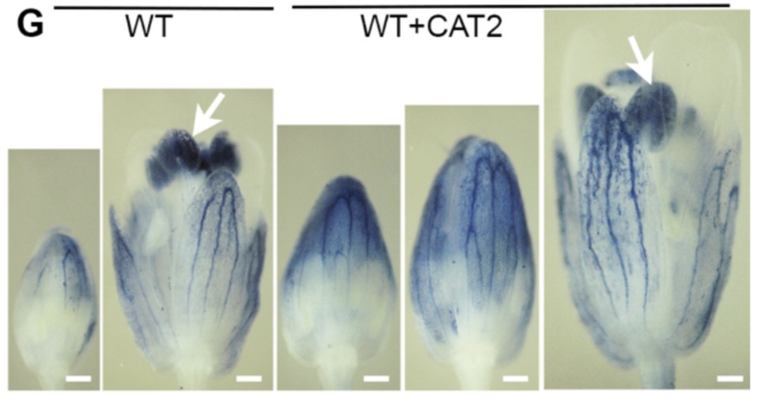
Sepal shape is affected by the overexpression of ROS-related genes
APX1 and CAT2: two genes that decrease ROS.
RBOHD: a gene that produces ROS
Right: In sepals, CAT2 overexpression causes delayed initiation of arrest front
Hong et al, Developmental Cell, 2016

Slide 8
Sepal shape is affected by the overexpression of ROS-related genes
“WT”
AF Initiation Height = 6
“WT+RBOHD”
AF Initiation Height = 4
Hong et al, Developmental Cell, 2016
“WT+CAT2”
AF Initiation Height = 8

Slide 9
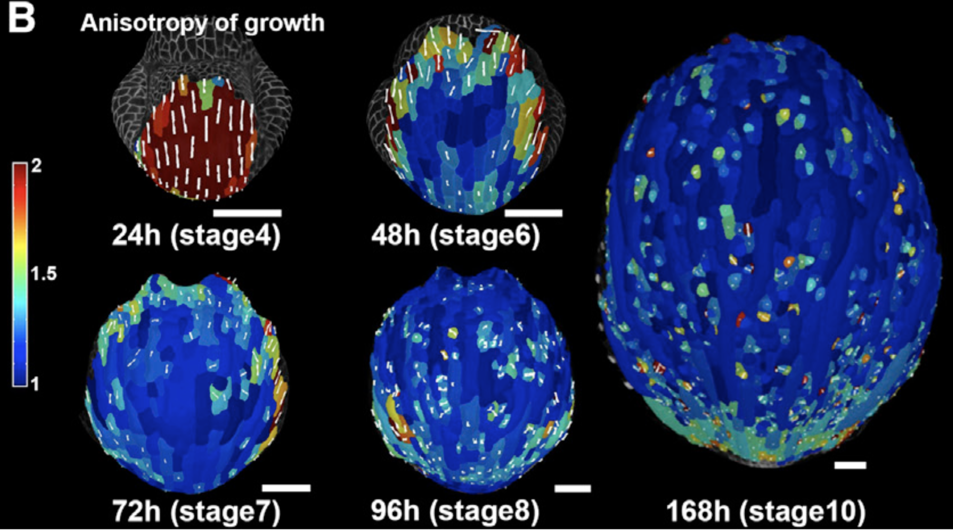
Changing anisotropy value affects shape of the leaf
Hong et al, Developmental Cell, 2016
Anisotropy value
0.1
0.2
0.3
0.4
Decrease linearly with height from 0.6 to 0.1
Used in Hong et al, Developmental Cell, 2016
Final shape
However, we should be cautious when changing mechanical parameters (the change may not have physical relevance).
Hervieux et al., Current biology, 2016

Slide 10
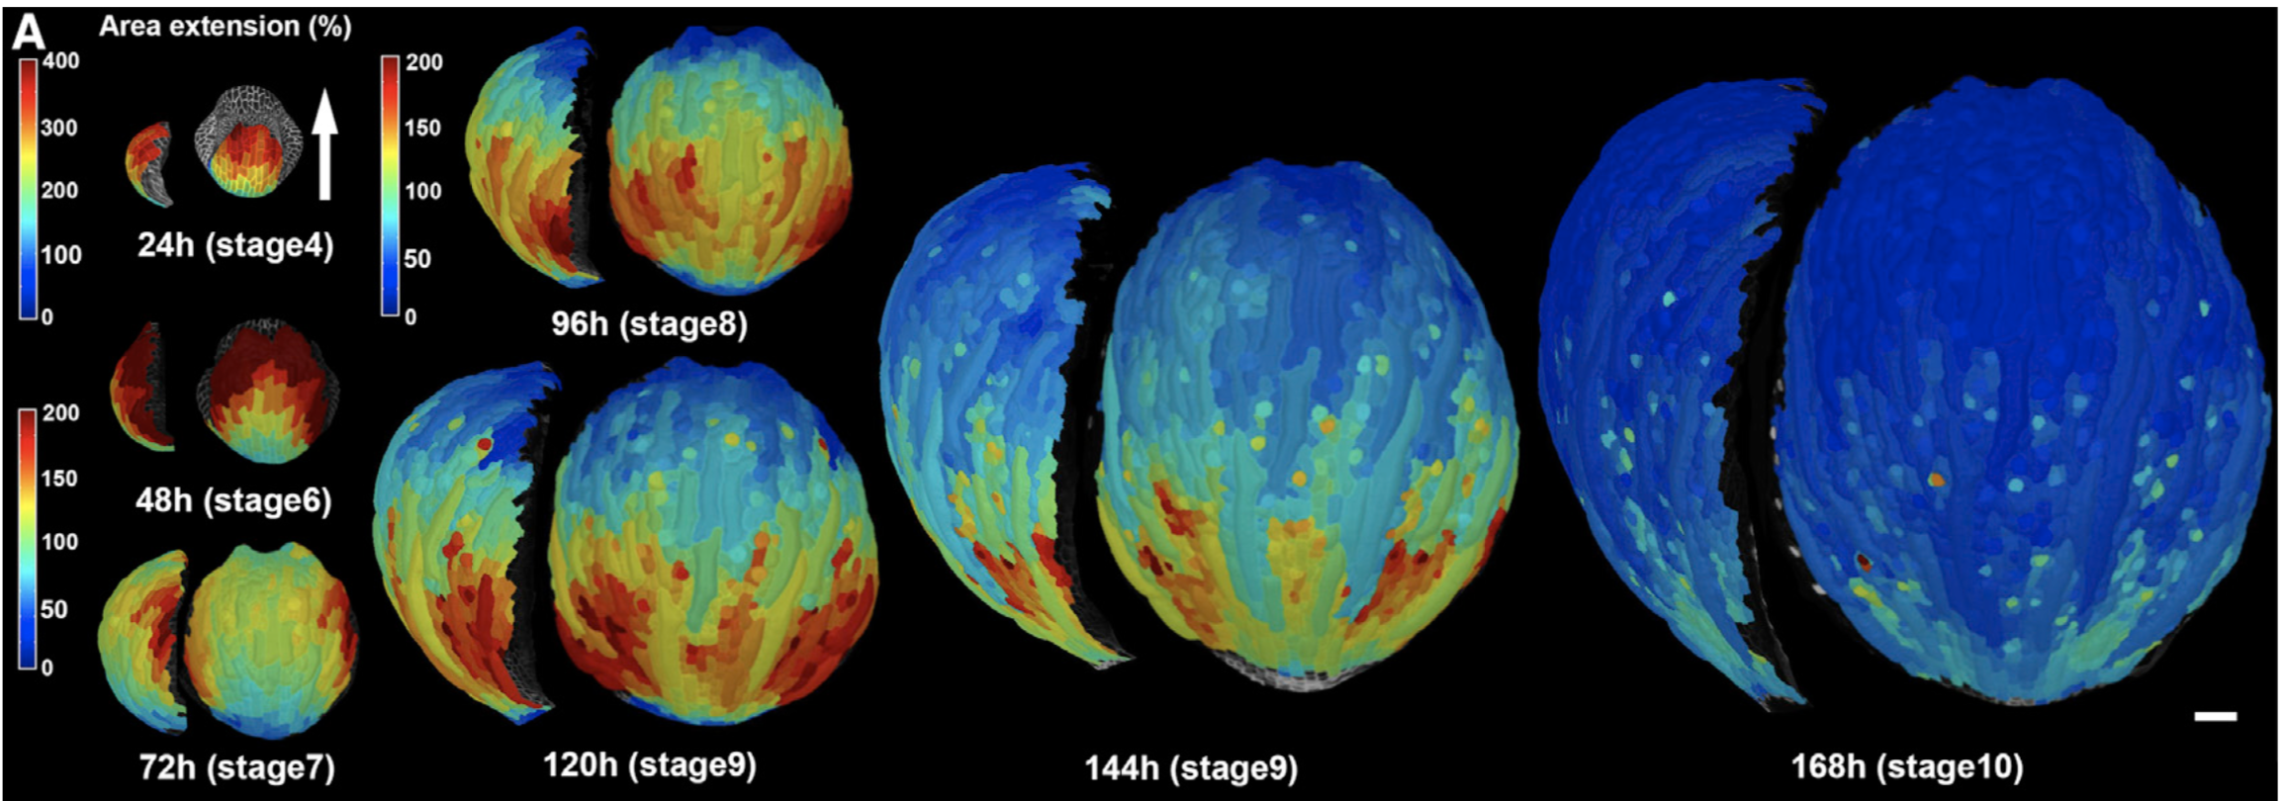
Growth rate pattern in the model differs from the real sepal
Growth Rate
Hervieux et al., Current biology, 2016

Slide 11
Growth rate pattern in the model differs from the real sepal
Growth rate
However, adding a growth inhibitor to the base produce weird-shaped, pointed sepals
(preliminary data)
Hervieux et al., Current biology, 2016

